Slide 1

Project 2 : Cellular response to drug perturbations
Ann- Sophie Kröll, Jana Braunger & Anna Münch
Supervisor: Nicolàs Palacio-Escat and Javier Perales-Patón
Tutor: Julia Rühle - 15.05.2019

Slide 2
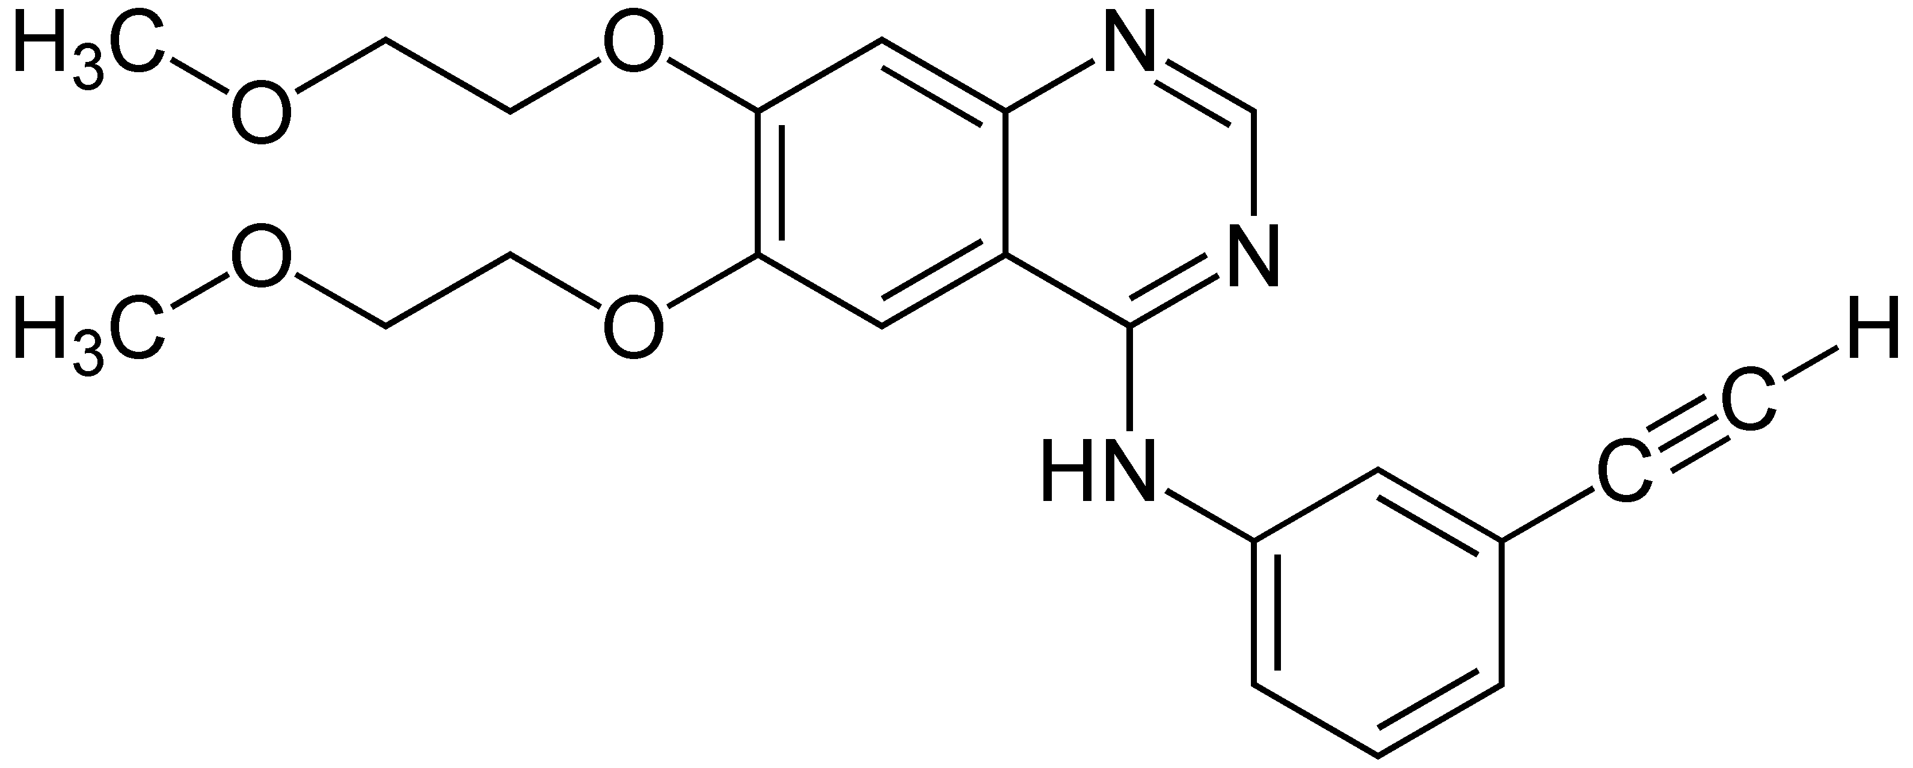
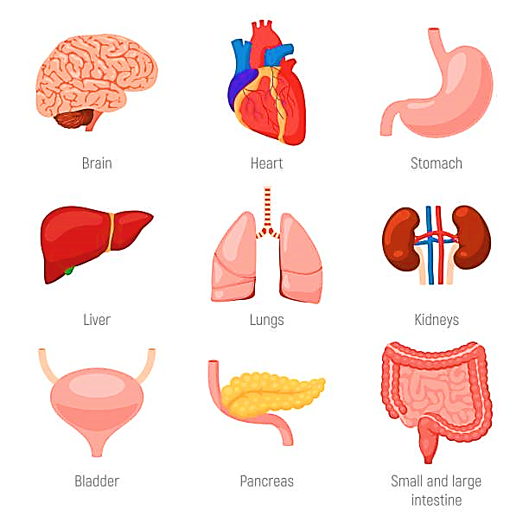
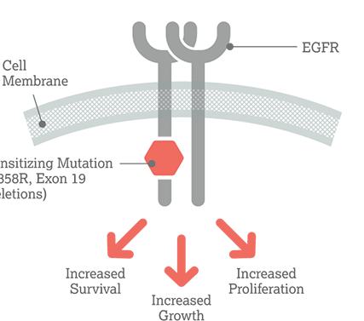

Erlotinib
Kinase inhibitor (EGFR, Her 1 receptor)

Slide 3

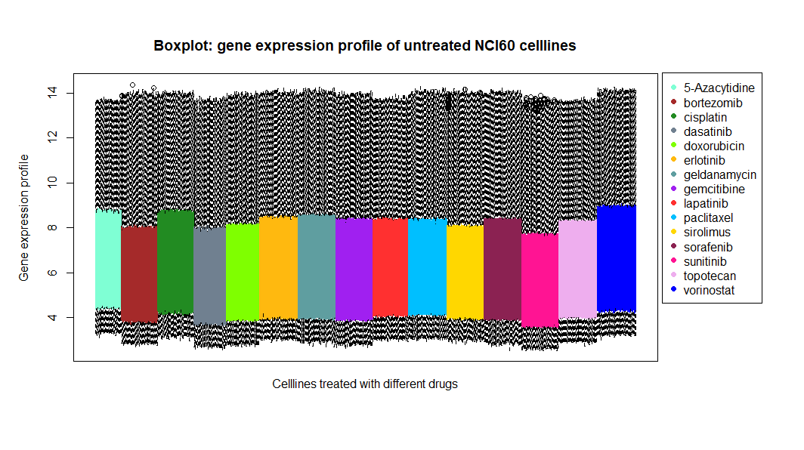
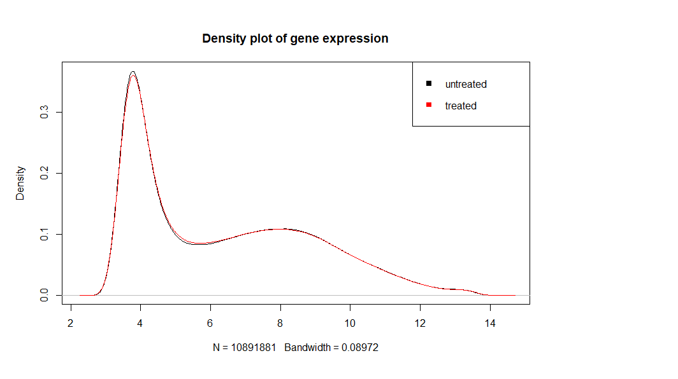
1. Milestone - Broad analysis
Expression profiles:
Boxplot
Density plot

Slide 4
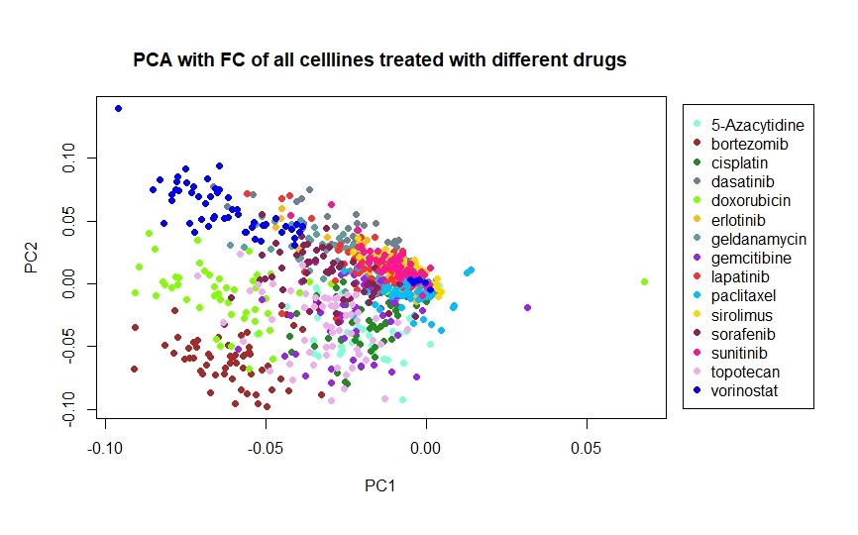
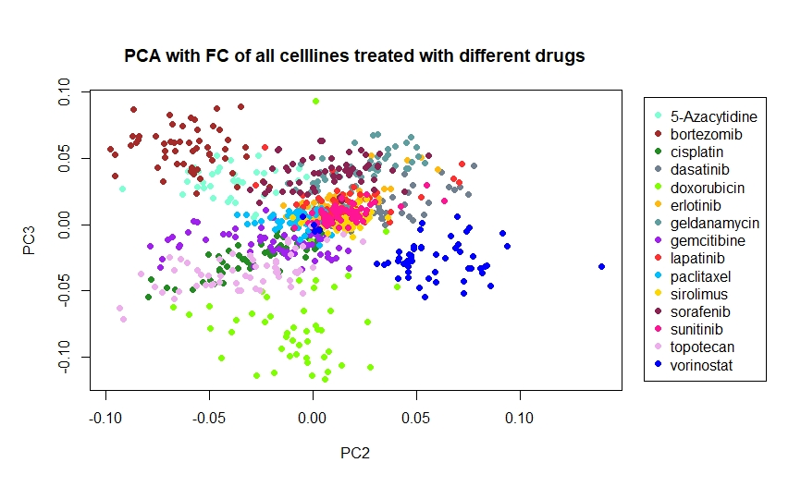
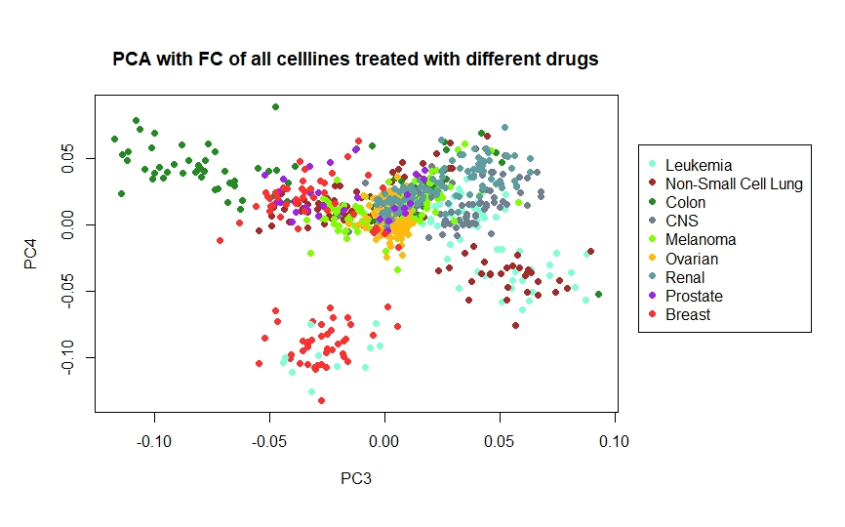
1. Milestone - Broad analysis
Select biomarkers for each cell line

Slide 5


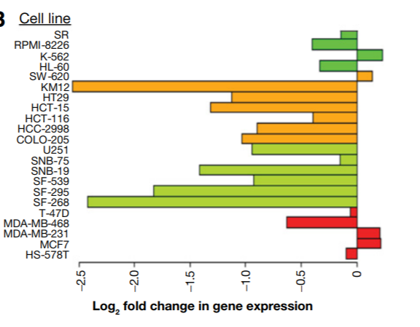
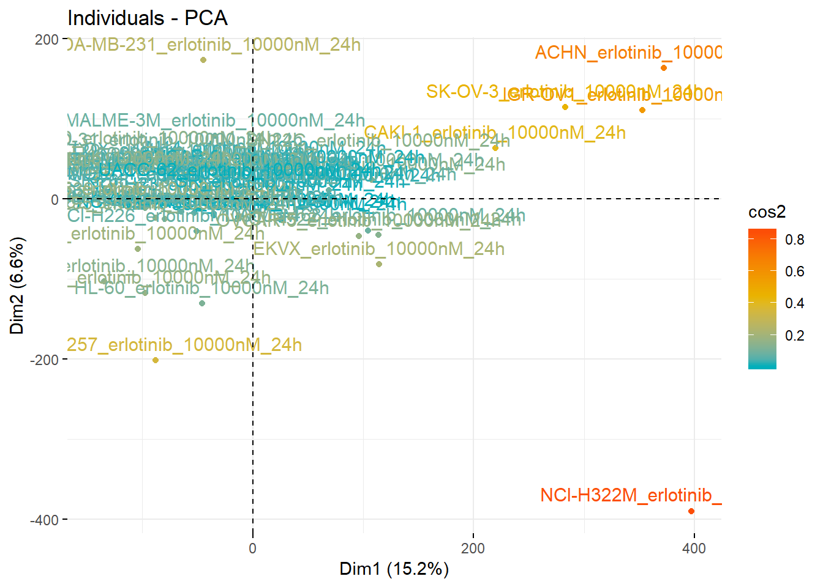
2. Milestone – Which genes and cell lines exposed the most change in regulation after Erlotinib treatment?
Cell Lines
Via PCA
Greatest variance in FC
Notes:
Differences between cell lines are more relevant to expression than drug treatment in PCA -> Treated (logarithmic data) - untreated (logarithmic data)
three most regulated genes
for 15 cell lines and colour the cancer type

Slide 6
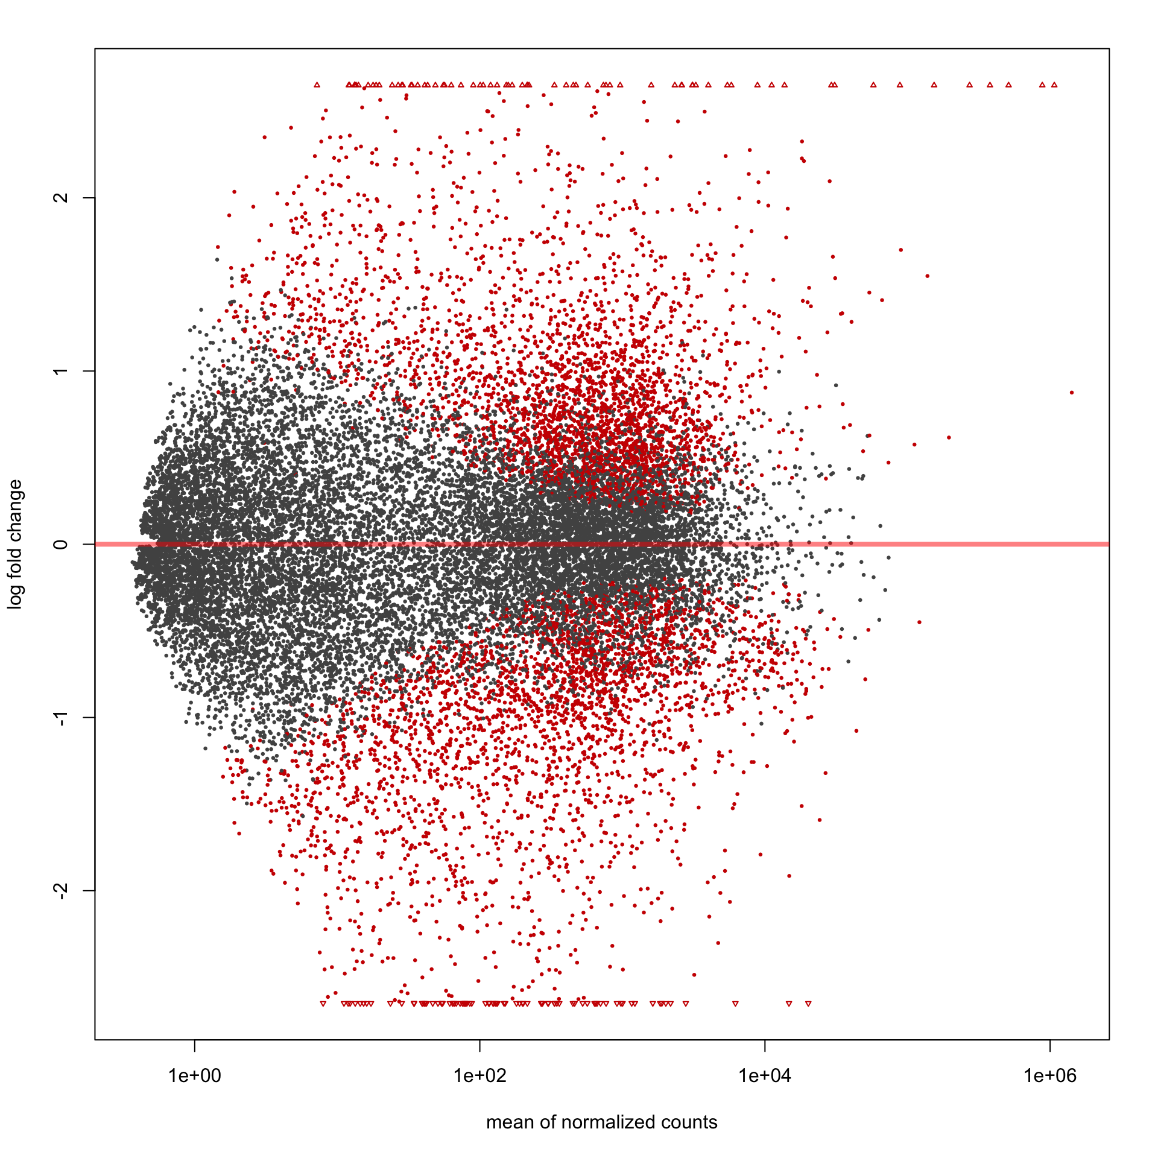
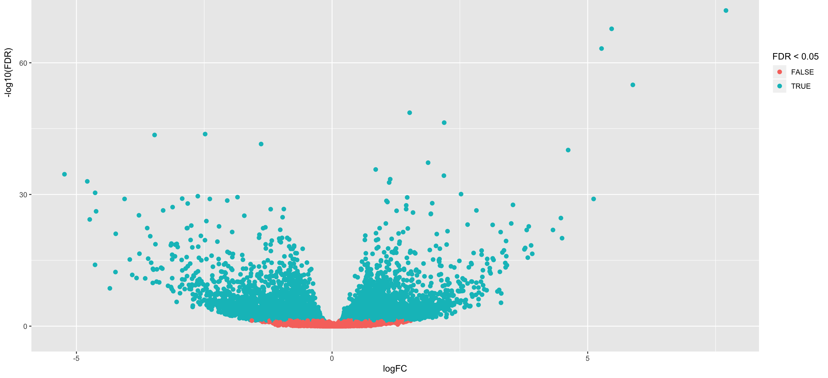
2. Milestone – Which genes and cell lines exposed the most change in regulation after Erlotinib treatment?
Genes
MA plot (of one cell line)
Volcano plot
(FC against FDR – t-test)
Single gene response plot
Notes:
Differences between cell lines are more relevant to expression than drug treatment in PCA -> Treated (logarithmic data) - untreated (logarithmic data)
three most regulated genes
for 15 cell lines and colour the cancer type

Slide 7

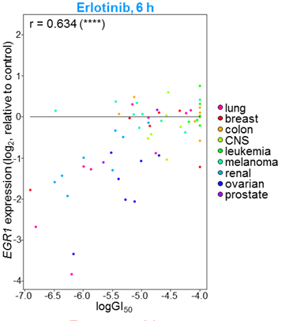
3. Milestone – Does the fold change correlate with cell growth inhibition?
median of gene expression changes
Paired t-test
Wilcoxon signed rank test
Spearman Correlation with FC and GI50
→ linear regression
→ compare with 6h timepoint (Fig. S2)
→ compare with untreated cells

Slide 8
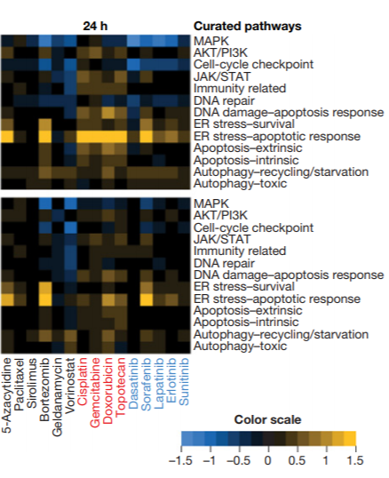
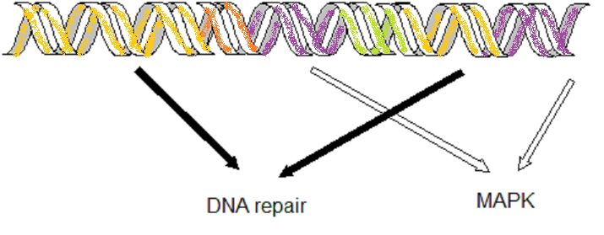
4. Milestone – Which cellular pathway’s are influenced by Erlotinib?
PROGENy or NCI
→ affected cellular pathways
Heatmap: cell-lines vs. pathways
(median of FC of relevant genes)
Comparison with other drugs
15 Cell lines

Slide 9
Time schedule
Broad Analysis
Influenced Cell Lines
Influenced
Genes
Correlation with cell proliferation
Influenced Pathways
Wed, 22.05.

Slide 10

Time schedule
Broad Analysis
Influenced Cell Lines
Influenced
Genes
Correlation with cell proliferation
Influenced Pathways
Wed, 05.06.

Slide 11
Time schedule
Broad Analysis
Influenced Cell Lines
Influenced
Genes
Correlation with cell proliferation
Influenced Pathways
Wed, 19.06.

Slide 12
Time schedule
Broad Analysis
Influenced Cell Lines
Influenced
Genes
Correlation with cell proliferation
Influenced Pathways
Wed, 03.07.

Slide 13
Time schedule
Broad Analysis
Influenced Cell Lines
Influenced
Genes
Correlation with cell proliferation
Influenced Pathways
Wed, 17.05.

Slide 14

NCI Transcriptional Pharmacodynamics Workbench
15 drugs → Erlotinib
2 concentrations ( c_{max} , GI₅₀)
12,704 genes
NCI-60-Cell line
Comparison untreated and treated transcriptional expression

Slide 15

Data sets
Name | Discription | Transformations | Data Type
NCI_TPW_gep_treated/ untreated | Gene expression profiles Rows: genes Columns: samples | Log₂ transformed | Matrix
NCI_treated_metadata | Metadata from expressionprofiles |  | Dataframe
NeglogGI50 | Drug sensitivity profile (50% growth inhibition) Rows: drug Columns: cancer cell lines | -log₁₀ transformed | Matrix
CCLE_mutations | Somatic mutations of cancer cell lines |  | Dataframe
CCLE_copynumbers | Gene copy number atteations | Log₂ transformed | dataframe
CCLE_basalexpression | Basal gen expression of cell lines | Log₂ transformed | Dataframe
Cellline_annotation | Type, Doubling Time, Mutationrate, Microsatellite instability |  | Dataframe
Drug_annotation | mean GI50 (µM), Mechanism, clinical phase, target, disease area |  | Dataframe

